Slide 1
Topic
Projectile Motion

Slide 2
Contents
Projectile Motion
Trajectory of Projectile
The Horizontal Range
Problems

Slide 3
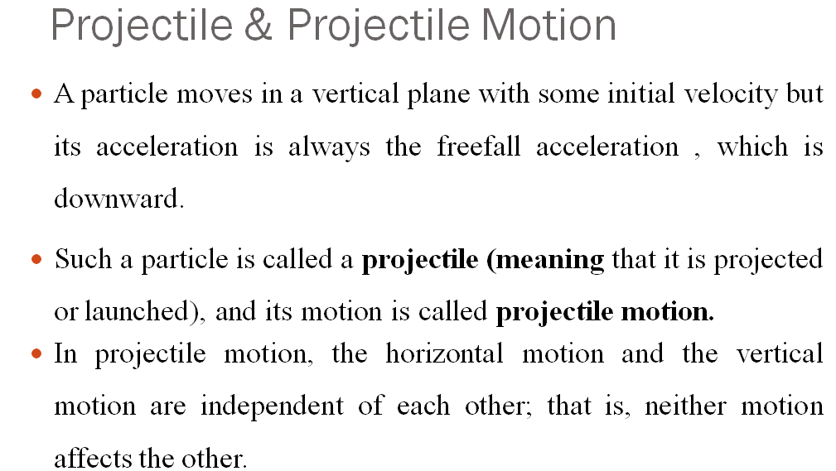

Slide 4
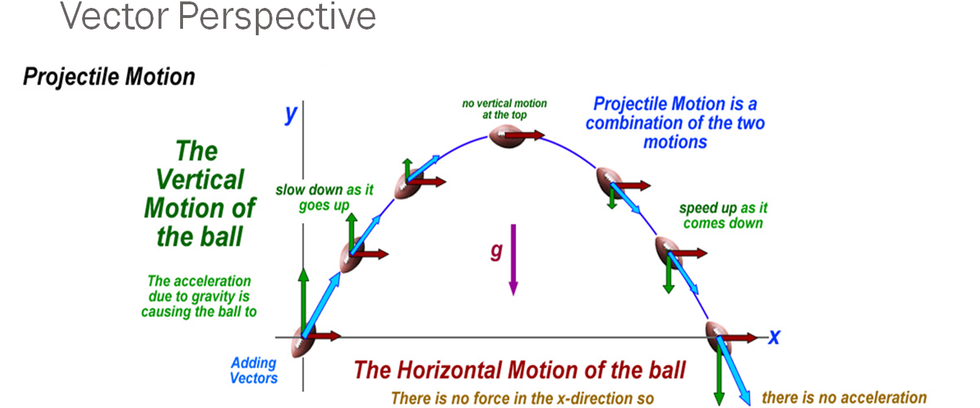

Slide 5
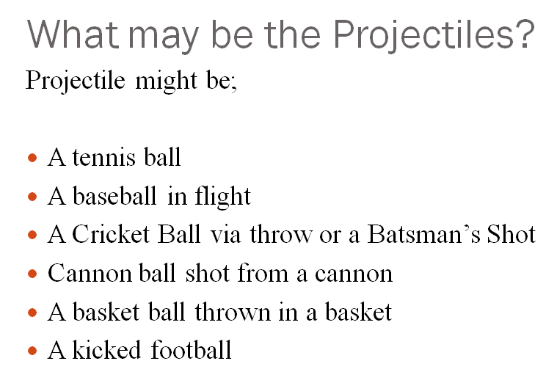

Slide 6
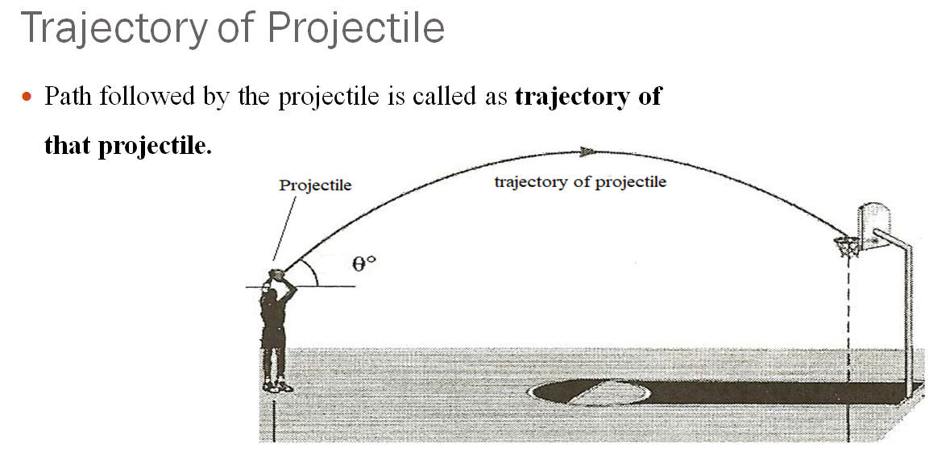

Slide 7
Analysis of Projectile Motion
The Horizontal Motion
The Vertical Motion

Slide 8

The Horizontal Motion
Because $a_{x}=0$ , horizontal motion remains constant through-out the trajectory.
$V_{0x}= V_{x}=$ $V_{0}cosθ$
At any time t , the horizontal motion (displacement) is $x= {(V}_{0}cosθ)t$

Slide 9
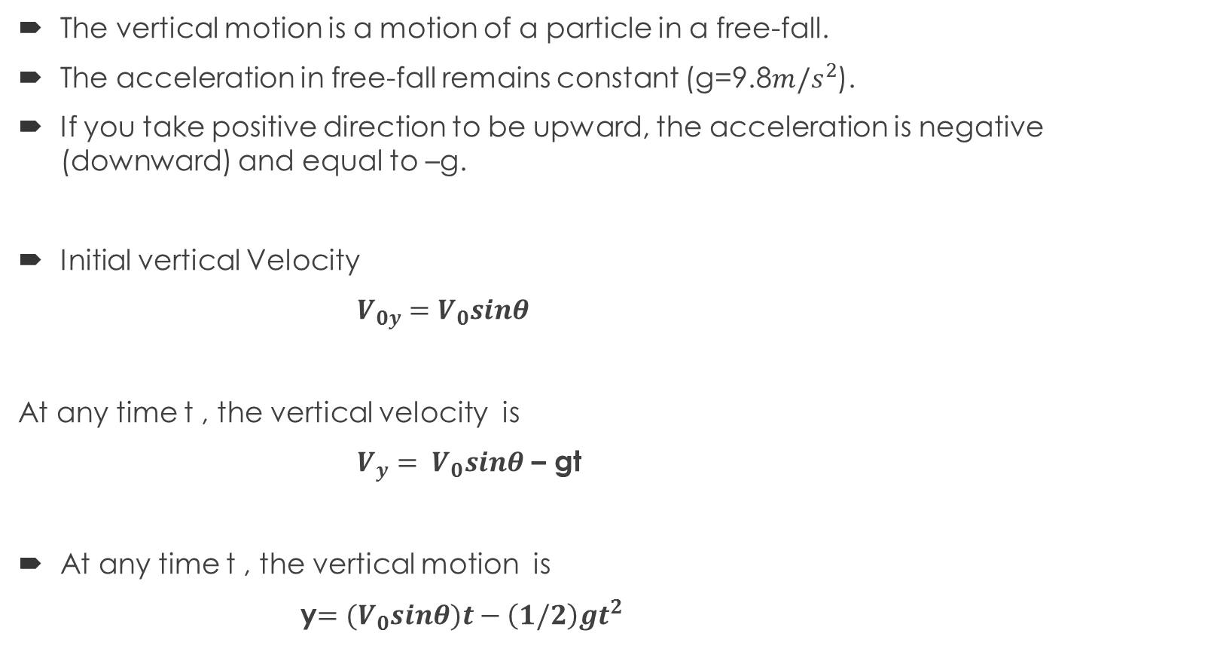
The Vertical Motion
The vertical motion is a motion of a particle in a free-fall.
The acceleration in free-fall remains constant (g=9.8${m/s}^{2}$).
If you take positive direction to be upward, the acceleration is negative (downward) and equal to –g.
Initial vertical Velocity
$V_{0y}=$ $V_{0}sinθ$
At any time t , the vertical velocity is
$V_{y}= V_{0}sinθ$ – gt
At any time t , the vertical motion is
y$={(V}_{0}sinθ)t−\left(1/2\right)gt^{2}$

Slide 10
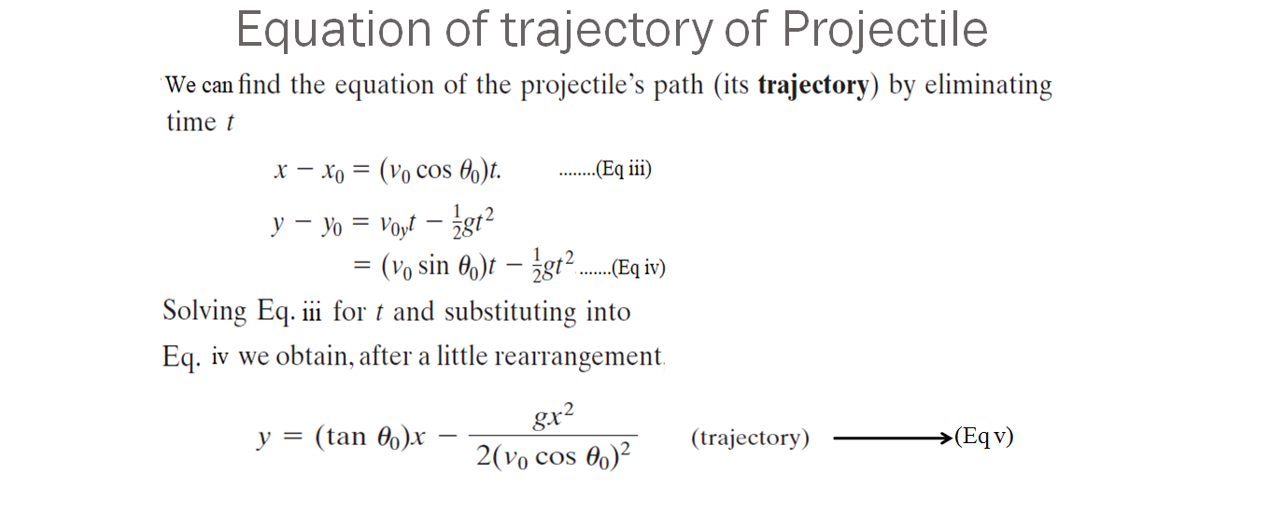

Slide 11
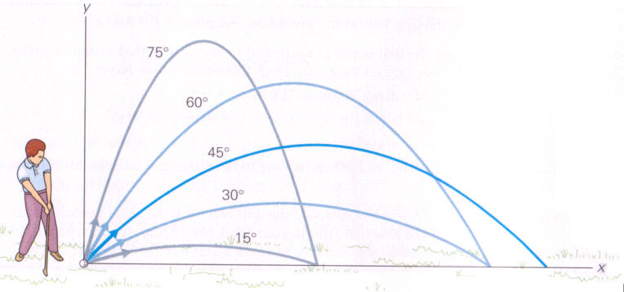

The Horizontal Range
The Horizontal range R of the projectile is the horizontal distance the projectile has traveled,
when it returns to its initial height(the height at which it is launched).
R = $\frac{V_{0}^{2}(2sinθcosθ)}{g}$ = $\frac{V_{0}^{2}(sin2θ)}{g}$

Slide 12
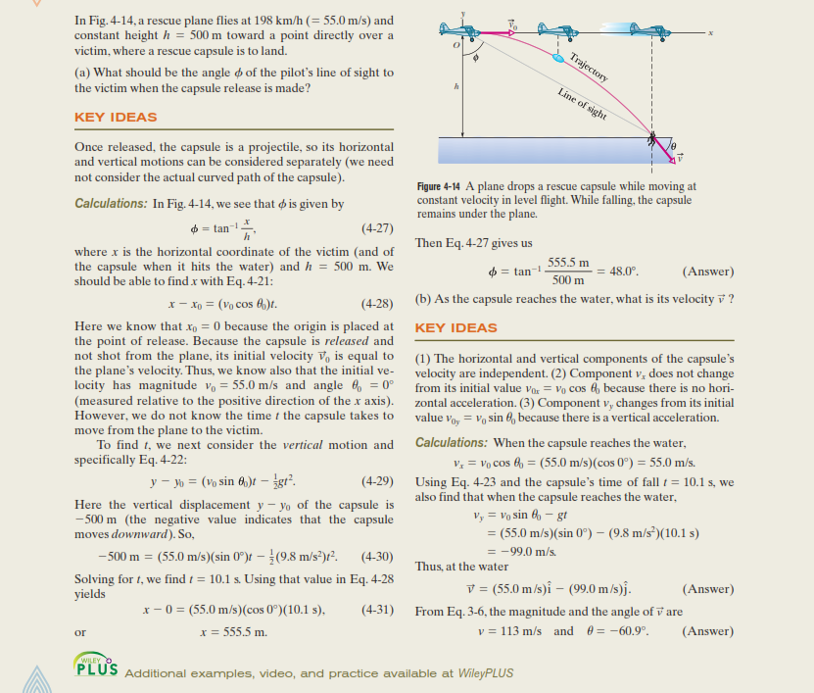
Problems Sample Problem: 4.04

Slide 13
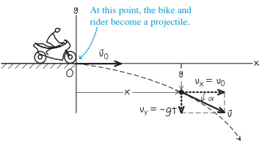
A motorcycle stunt rider rides off the edge of a cliff. Just at the edge his velocity is horizontal, with magnitude of 9.0 m/s. Find the motorcycle’s position, distance from the edge of the cliff, and velocity 0.50 s after it leaves the edge of the cliff.
Answer:
X= 4.5 m, y = -1.2 m.
r = 4.7 m.
V= 10.2 m/s.

